Slide 1
Calls Data Report Assignment for Hunt Digital Media
By Palak

Slide 2
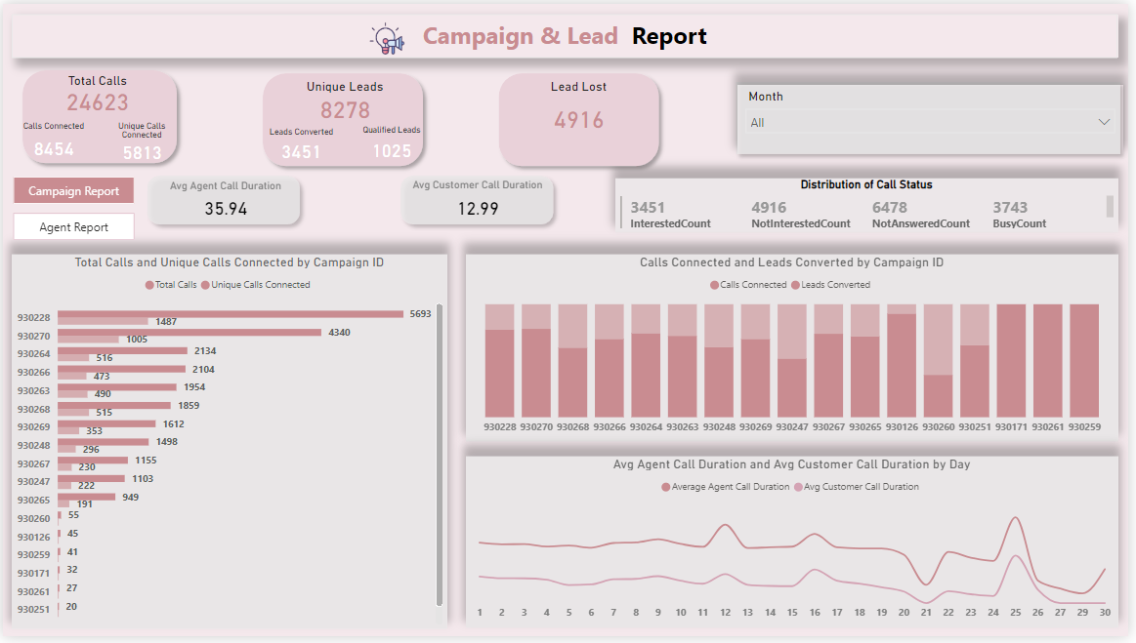

Slide 3
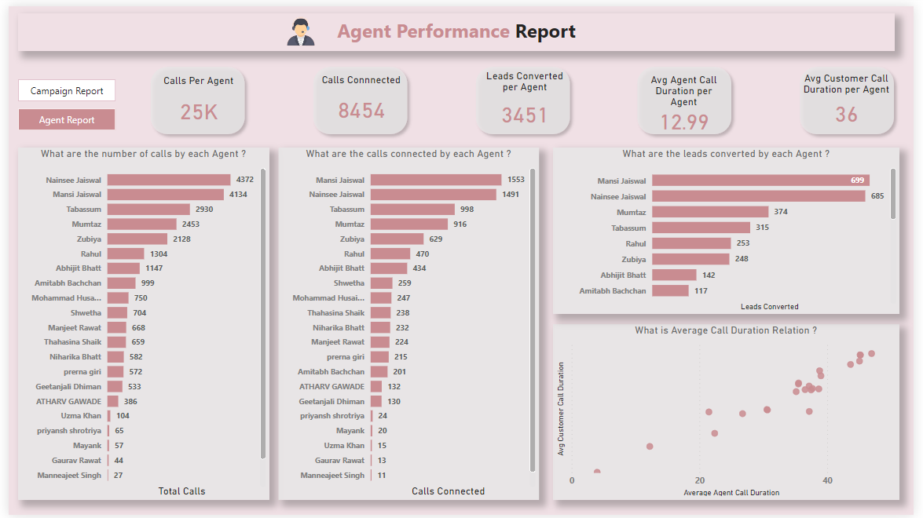

Slide 4
Thank you!

